Slide 1


Vaagdevi Engineering College BRAIN TUMOR DETECTION FROM MRI IMAGES (Using Convolutional Neural Networks)
- Smart Bridge – Remote Internship program
TEAM-8
UPPULA GNANESHWARI 17UK1A0571
NIKHITHA SRIPADA 17UK1A0584
NAVYA RUMANDLA 17UK1A0577
MANCHUPELLY HARISH 17UK1A0599
Under the guidance of – Mr.Ranadheer Reddy

Slide 2
contents
INTRODUCTION
PROPOSED SOLUTION & ALGORITHM
SOFTWARE DESIGNING
ADVANTAGES & DISADVANTAGES
APPLICATIONS
RESULT
CONCLUSION

Slide 3
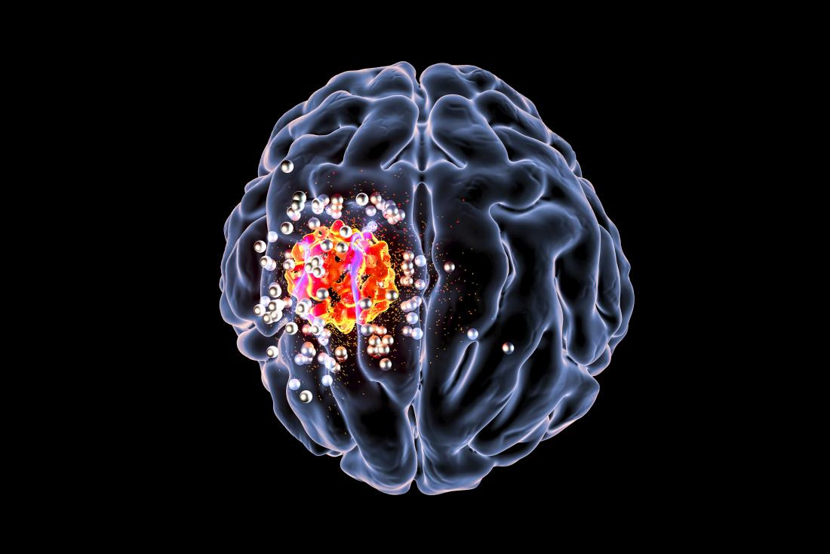
What Actually Brain Tumor Is ?
A brain tumor is a mass of abnormal cells in brain .Different types of brain tumors exist . Some brain tumors are noncancerous(benign),and some of them are cancerous(malignant).
If the tumor is not detected in earlier stages , it will put the person’s life in danger , mostly leads to death . So , it is very important to detect the brain tumor as early as possible.

Slide 4

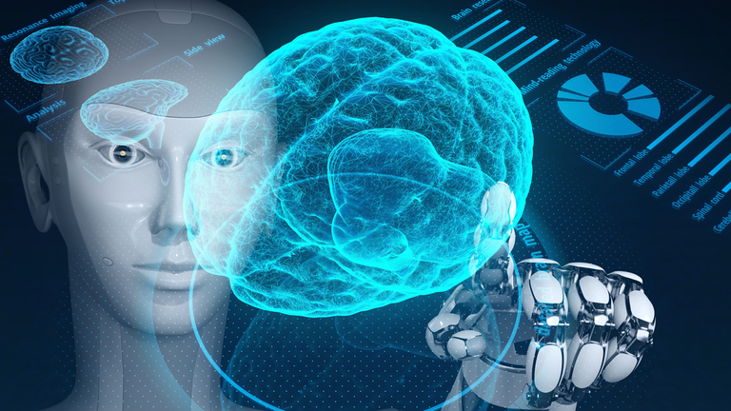
INTRODUCTION
​DI ​
Diagnosis of a brain tumor is done by a
neurologic exam (CT,MRI).
The detection of brain tumor using MRI
images is a challenging task because of
the complex structure of brain.​
The MRI images can be processed and one can detect the brain tumor using image preprocessing technique by forming an automatic detection process
using algorithms.​
MRI images plays an important role in brain tumor for analysis , diagnosis and treatment planning. ​

Slide 5
Proposed solution & Algorithm
Deep Learning (Convolutional Neural Network)
In deep learning, a Convolutional Neural Network is a class of deep neural networks, most commonly applied to analyzing visual imagery. CNNs take advantage of the hierarchical pattern in data and assemble more complex patterns using small and simple patterns. Therefore, on the scale of connectedness and complexity, CNNs are on the lower extreme.
We also created an UI using the Flask for the brain tumor recognition. This UI will allow the users to check whether they are suffering with tumor or not. It can be done just by uploading the MRI image of their brain. This is a user friendly and easily understandable interface.

Slide 6
Software Designing
We have developed this model , using ML algorithms and with the help of other environments .
● Jupyter Notebook Environment
● Spyder Ide
● Deep Learning Algorithms
● Python (pandas , numpy)
● HTML
● Flask

Slide 7
ADVANTAGES
Easy and simple user interface for the people who are testing their brain to check whether they are effected by tumor or not.
Convolutional neural networks give the accurate result of the prediction up to 90% which we used for prediction.
It can work in real time and predict as soon as the necessary details for prediction are given to the model .Further treatment can be processed based on the results.
Needs only single MRI image for the prediction.
DISADVANTAGES
It only predicts the presence of tumor, but it will not predict the stage and size of the tumor.
It ask for the MRI images of brain which cannot be affordable by everyone.

Slide 8
APPLICATIONS
● Convolution Neural networks is a class of deep neural networks, most commonly applied to analyzing visual imagery, which can take in an input image, assign importance to various aspects/objects in the image and be able to differentiate one from the other are dealing with in real time.
● It is one of the most widely used in analysing the visual imagery in the Hospitals.
● By this model,we can directly analysis and predict the possibility of tumor cells without going to Hospitals etc. It saves time and money of people by directly providing an User interface using machine learning algorithms.
● So we use Machine Learning Algorithms to analyze the data and predict the tumor and propose the stage for treatment by MRI images,we can detect the tumor by using MRI images by sitting in our home.

Slide 9
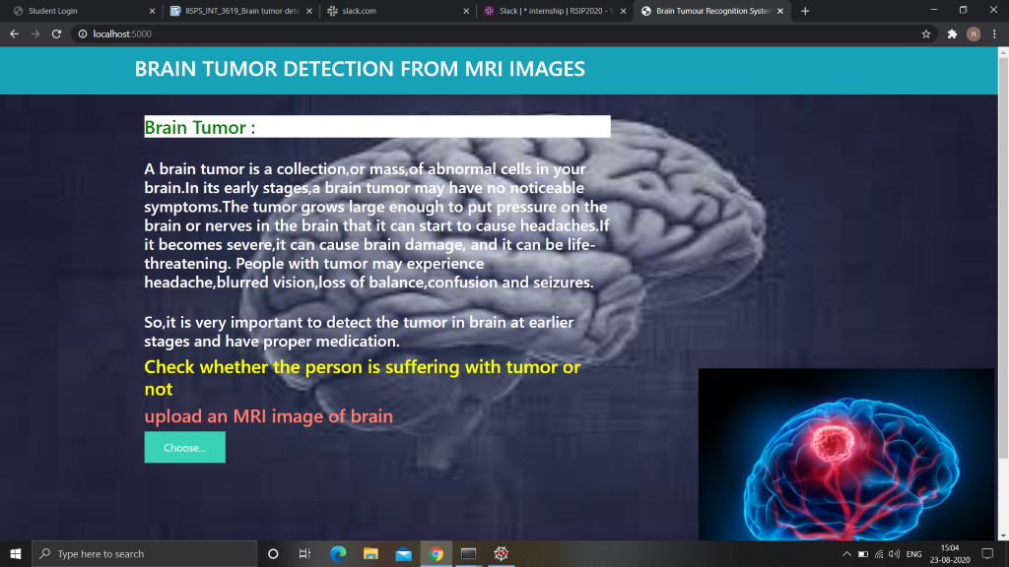
RESULT
In this page , after uploading the MRI image of brain , and by clicking on the check result button , the predicted result is displayed . The result shows whether the person is suffering with brain tumor or not.

Slide 10
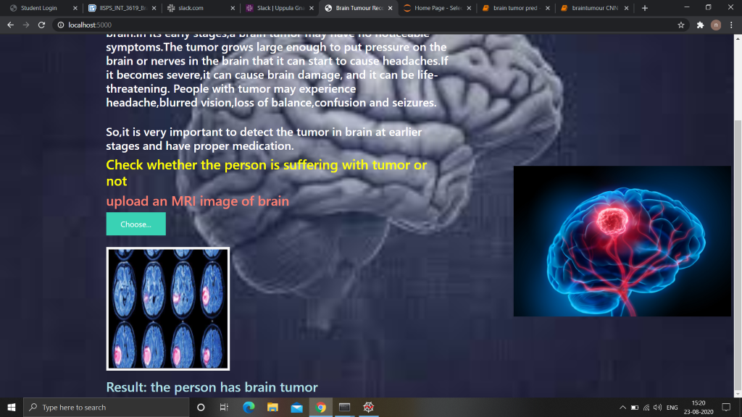

PREDICTING THE RESULT OF THE IMAGE AS “HAS TUMOR”

Slide 11
CONCLUSION
The CNN algorithm is adopted to build a UI model for predicting the image uploaded by the user.
Prediction depends on the accuracy of trained images.
The experiment says that CNN is easy to predict the result effectively than other NN algorithms.
THANK YOU

